Slide 1

ADVANCE TRAUMA
Effects of Advanced Trauma Life Support® Training Compared to Standard Care on Adult Trauma Patient Outcomes: A Stepped-Wedge Cluster Randomised Trial
Protocol Summary

Slide 2


Slide 3
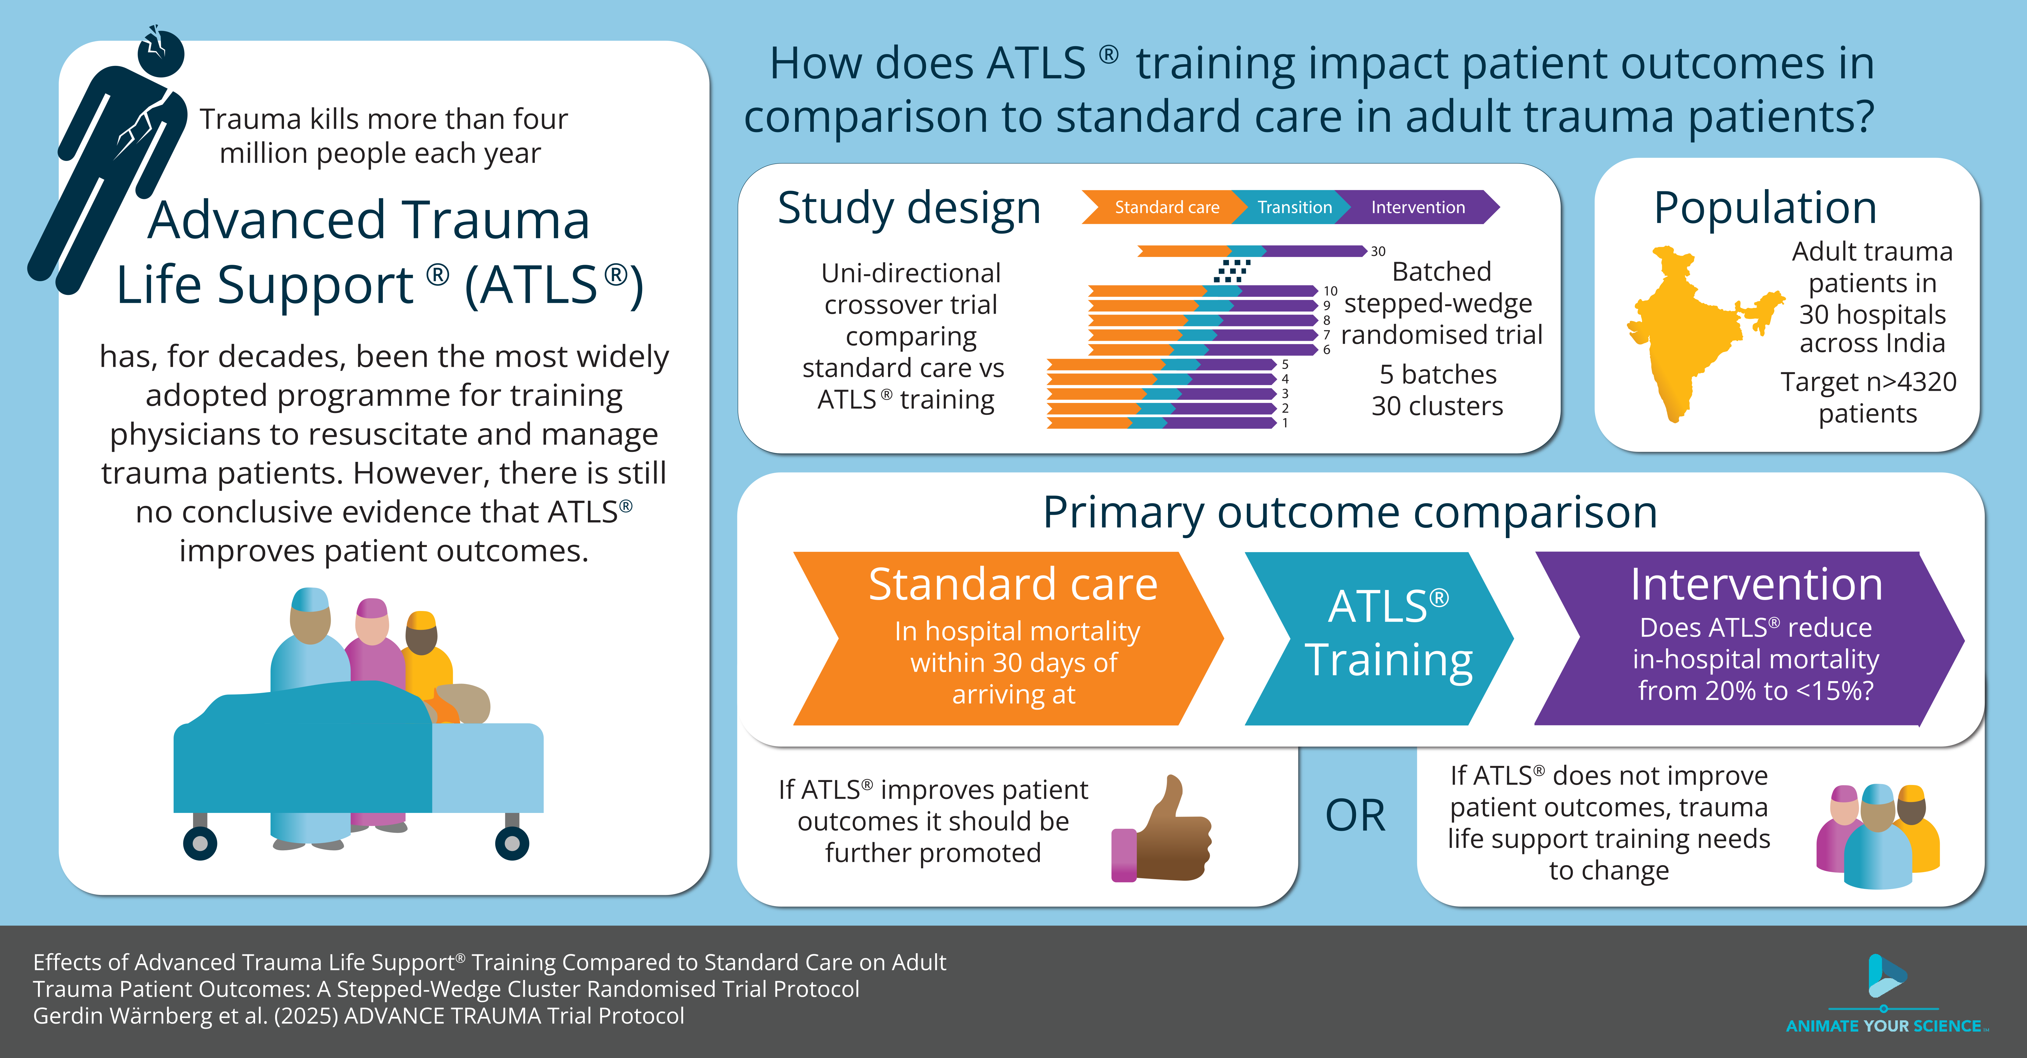

Slide 4
Trauma Scope of the problem
#1
cause of disease burden in people aged 10-49 years
4.3
million deaths globally
$4.2
trillions in the US alone

Slide 5
ATLS® Purpose and content
“emphasizes the rapid initial assessment and primary treatment of injured patients, starting at the time of injury and continuing through initial assessment, lifesaving intervention, reevaluation, stabilization, and, when needed, transfer to a trauma center”
> ATLS® Student Course Manual. 10th ed. 2018.

Slide 6
ATLS® Spread and dissemination
>1
million physicians trained
>80
countries worldwide
1978
first course

Slide 7
Aim To compare the effects of ATLS® training with standard care on outcomes in adult trauma patients

Slide 8
Design Batched stepped-wedge design cluster randomised design

Slide 9
Intervention and control ATLS and standard care
Intervention
2.5 day ATLS training course
Accredited ATLS training facility in India
1-2 units per hospital
Control
Standard care varies across hospitals in India
Trauma patients are initially managed by 1st or 2nd year resident
No formal trauma life support training

Slide 10
Outcomes Primary outcome
30-day in-hospital mortality
Collected through medical records for patients admitted or discharged home
Collected through telephonic follow-up for patients transferred to another hospital

Slide 11
Outcomes Secondary outcomes
All cause and in-hospital mortality at 24 hours, 30 days and 90 days
Quality of life, measured using EQ5D5L at 30 days and 90 days
Disability, measured using WHODAS 2.0 at 30 days and 90 days
Return to work, measured at 30 days and 90 days
Length of stay, in the ED, ICU and hospital

Slide 12
Sample size Effect size, cluster and patients
Detect a reduction in 30-day in-hospital mortality from 20 to 15% with 90% power
30 clusters
4320 patients
Requires at 12 patients per cluster and period (month)

Slide 13
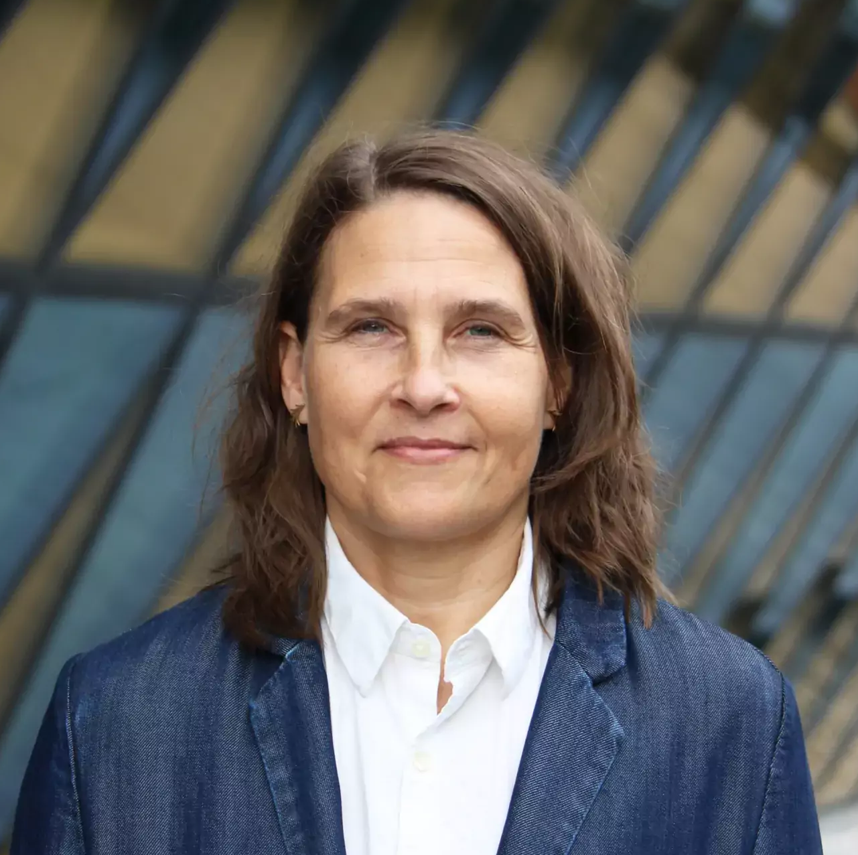
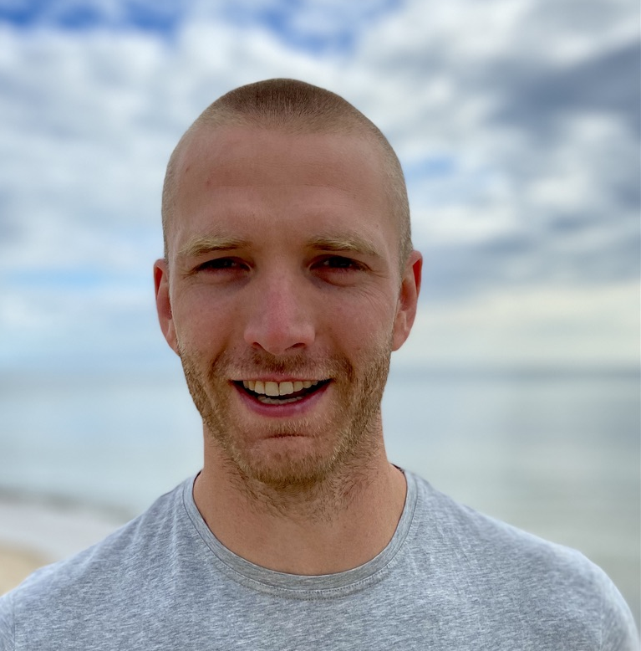

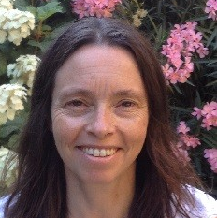
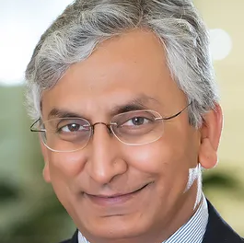



Trial organisation Main applicants
Lisa Strömmer
Ass. Professor
Martin Gerdin Wärnberg
Ass. Professor
Li Felländer-Tsai
Professor
Karla Hemming
Professor
Vivekanand Jha
Executive Director,
Professor

Slide 14
ADVANCE TRAUMA
advancetrauma.info
Protocol Summary

